Slide 1
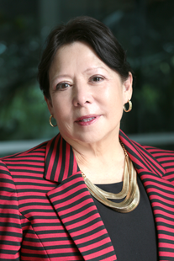
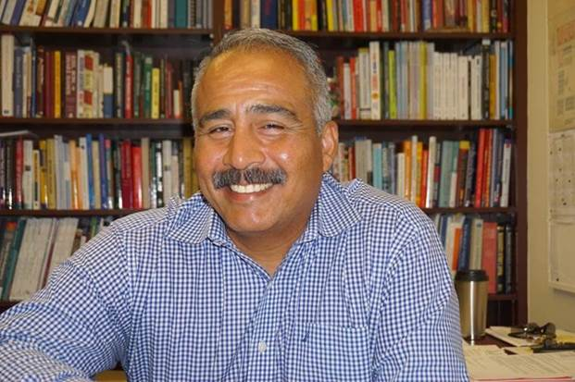

ACCJC
Updates & Follow-up Visit
Dr. Cynthia Azari, President
Rojelio Vasquez, Vice President/ALO

Slide 2

Sample 1
VISION AND VALUES REVIEW
All College Day Collaborative Process
Continuous Quality Improvement
STRATEGIC PLANNING • PROGRAM REVIEW • RESOURCE ALLOCATION • OUTCOMES
FEEDBACK & INPUT
Community Charrette
Campus-wide Charrette
Student Charrette
Environmental Scan/Institutional Data
STRATEGIC PLANNING
Creation of Strategic Planning Steering Committee and Strategic Plan.
INTEGRATED PROGRAM REVIEW
Academic Services, Student Support Services, Business/Administrative Services Integrated PEPC Processes
INTEGRATED RESOURCE ALLOCATION
Integrated PBC Processes
INSTITUTIONAL EFFECTIVENESS
Measuring what and how we are doing – Tableau Dashboards.
IMPACTING STUDENT SUCCESS & OUTCOMES

Slide 3





Sample 2
GPS
Guided Pathways Plan
Enrollment Management Plan
Revised Technology & Facility Plans
Distance Education Plan
Integrated Plan
(BSI, Equity, SSSP)
...
Additional Plans and Grants
STRATEGIC PLANNING
INTEGRATED PLANNING PROCESSES – IMPACTING STUDENT SUCCESS AND OUTCOMES

Slide 4

Sample 3
So…Where Are We Now?
Create & Vet Strategic Initiatives
Create & Vet Strategic Goals
STRATEGIC PLANNING PROCESS
100
90
80
Refine Objectives & Action Steps
70
Continue the Work!
60
50
40
30
20
10
Present Strategic Plan to BOT
In May 2018
Draft Strategic Plan
Vet Strategic Plan In April 2018

Slide 5


Sample 4
Strategic Planning Steering Committee (SPSC)
Program Effectiveness & Planning Committee (PEPC)
Planning & Budget Council (PBC)
Explain Involvement in Processes
Process used to integrate Program Reviews
Academic, Business/Admin, Student Support Services
Integrated Resource Allocation Process
Student Success
Charrettes, Vision/Value Review, Development of Strategic Initiatives, Goals, etc.
Continued Improvement and Involvement aligned with Strategic Plan
Integration of Program Review & Resource Allocation
Role(s) - Participation
Strategic Planning Process
Refinement of Program Review, Resource Allocation Processes
Integration into Participatory Governance Committees & Processes
Role(s) - Participation
Strategic Planning Process
Refinement of Program Review, Resource Allocation Processes
Continued Involvement
Implementation of the Strategic Plan and other Plans
Continued Involvement
Implementation of the Strategic Plan and other Plans
Continued Involvement
Implementation of the Strategic Plan and other Plans
Academic Senate
Classified Senate
Student Government

Slide 6

Sample 5
Long-Range
Complete Strategic Planning Process
Maintain Full Compliance with ACCJC
Implement Strategic Objectives and Action Steps & Monitor Outcomes
Integrate Education Master Plan, Strategic Plans and all Other Plans
Dashboards
2016
2018
2018
2023
2018
2020
2019
2023
ACCJC Site Visit

Slide 7

Sample 7
ACCJC New Direction
Change, It’s Here!
Highlights
Heavy Emphasis
…on Improving:
Institutional Effectiveness
Analyzation,
Utilization,
Implementation,
Impact on Outcomes.
Major Shift
… in perception! ISER is step 1 of a 7-year process rather than seeing it as a culmination of the last 7 years.
…Focus is on improving student success not just compliance with standards
.
New Taxonomy
New taxonomy of ACCJC standards to enable a holistic institutional review and impact on student success
Manageable, meaningful and Mission-centered!
Simplified Metrics
Input, Process, Output
Integrated
Planning
Program Review
Resource Allocation
Impact and Outcomes

Slide 8

Sample 8
QUESTIONS ?

