Slide 1
Student Engagement
An engaging presentation
presented engagingly
by Teresa Bonham and Gaylene Croker

Slide 2
Student Engagement
Teaching and learning share an interesting relationship. Just because there is teaching in a classroom does not mean that there is also learning in that same classroom.

Slide 3
Student Engagement

Slide 4
Student Engagement Issues
As current educators, we are dealing with several issues when we look at how to engage our students. First, we are working with students who are used to gathering information at a quicker rate than our lectures; second, we are teaching a diverse group whose academic preparedness is equally diverse.

Slide 5
Defining Student Engagement
Student engagement does not mean entertaining them. To me, student engagement means that students are actively learning. They take an active role in the course material; they want to learn.

Slide 6
Active Learning
In active learning, a teacher does not need to radically change, but a teacher may need to shift occasionally from being the sage on the stage to being a guide on the side, or a coach, or a facilitator.

Slide 7
Active Learning: Sharing
We both teach English. If we had a nickel for every time students say they hate English, we would no longer need to teach English because we would be stinking rich.
We have both had success converting these naysayer students into actively engaged students and a couple of English majors.

Slide 8
Learning Through Games
There are different games to achieve different classroom goals. We will present the following:
Dinner Party (critical thinking)
Talk Show (critical thinking)
Poll (facts and recall & assessment)
Team Jeopardy (facts and recall)

Slide 9
Dinner Party
This activity can be used to help students synthesize information and implement critical thinking in your class.
Students are asked to plan a dinner party for six or more guests. They can decide who to invite, but there must be a unifying theme. The students need to be able to identify and explain why they have chosen these guests, what the topics of discussion might be.

Slide 10
Talk Show
This activity encourages critical thinking skills and can be used for a review of major concepts/characters.
Students get into groups and create various questions pertaining to the subject at hand. They pass these on to the next group who answer the questions.
One student in each group is assigned a role and comes up to front of class to participate in “talk show.”

Slide 11
Poll
Polling is a way to take the class’s pulse while you lecture through asking them specific questions related to your goals.

Slide 12
Low Tech Poll
There are a couple of techniques for low tech poll. One way is to stop your lesson and ask students to give you a signal if they understand or not. I ask for a thumbs up or a thumbs down.
Another low tech poll technique is to give students a specific question and give them five to ten minutes to answer the question in writing.

Slide 13
High Tech Poll
Just like American Idol, have your students text their response to you, live and use that information to adjust your teaching or incorporate the information into your lecture.
Use http://www.polleverywhere.com/ to create free text polling.

Slide 14
Presenter Text Polling Notes
Explain what’s going on
“Now I’m going to ask for your opinion. We’re going to use your phones to do some audience voting just like on American Idol. So please take out your cell phones, but remember to leave them on silent.”
“The way you will be able to participate is by sending a text message. If you don’t know how to do that, just ask your kids! Or have your neighbor help you figure it out.”
Address their concerns
“This is a just standard rate text message, so it may be free for you, or up to twenty cents on some carriers if you do not have a text messaging plan.”
“The service we are using is serious about privacy. I cannot see your phone numbers, and you’ll never receive follow-up text messages outside this presentation. There’s only one thing worse than email spam – and that’s text message spam because you have to pay to receive it!”
Use a demo or practice poll
Set up the Free Text Poll to ask “Let’s Practice: Text in your first name!”
Notes:
This slide is just for your own notes, as a presenter or instructor. You may print these off, memorize them, or actually put them into the Notes portion of a slide in your own presentation.

Slide 15
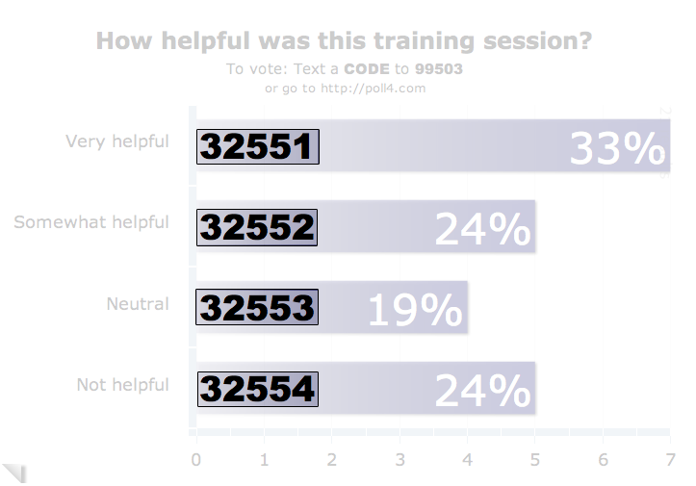
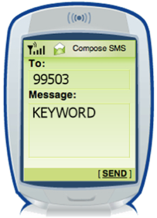
How To Vote via Texting
EXAMPLE
Standard texting rates only (worst cast US$0.20)
We have no access to your phone number
Capitalization doesn’t matter, but spaces and spelling do
TIPS
Notes:
This slide is for display to the audience to show them how they will vote on your polls in your presentation. You can remove this slide if you like or if the audience is already comfortable with texting and/or voting with Poll Everywhere.
Sample Oral Instructions:
Ladies and gentlemen, throughout today’s meeting we’re going to engage in some audience polling to find out what you’re thinking, what you’re up to and what you know. Now I’m going to ask for your opinion. We’re going to use your phones to do some audience voting just like on American Idol.
So please take out your cell phones, but remember to leave them on silent. The way you will be able to participate is by sending a text message.
This is a just standard rate text message, so it may be free for you, or up to twenty cents on some carriers if you do not have a text messaging plan. The service we are using is serious about privacy. I cannot see your phone numbers, and you’ll never receive follow-up text messages outside this presentation. There’s only one thing worse than email spam – and that’s text message spam because you have to pay to receive it!

Slide 16
Question 1
Standard texting rates only (worst cast US$0.20)
We have no access to your phone number
Capitalization doesn’t matter, but spaces and spelling do
TIPS
Notes:
Press F5 or enter presentation mode to view the poll
If you wish, we hope you use this slide as a template for your own voting slides. You probably need to do something like this template if you feel your audience needs a lot of extra assistance in terms of how to vote via text, web, or Twitter.

Slide 17
Question 2
Standard texting rates only (worst cast US$0.20)
We have no access to your phone number
Capitalization doesn’t matter, but spaces and spelling do
TIPS
Notes:
Press F5 or enter presentation mode to view the poll
If you wish, we hope you use this slide as a template for your own voting slides. You probably need to do something like this template if you feel your audience needs a lot of extra assistance in terms of how to vote via text, web, or Twitter.

Slide 18
Team Jeopardy
Break the class into teams.
Allow each team to choose a unique name.
If you have a strong student who won’t buy into the activity, give that student a job of scorekeeper, or fact checker.
Tell the class your rules. My rules are no raising your board until the question has been totally asked and if you know an answer is wrong, raise your board to steal the points.

Slide 19
Team Jeopardy
There are different ways for you to create your game board. You can use Powerpoint and make a high tech game, you can do as I often do and use transparencies, or you can do the super low tech and use paper, tape and a board.
You must be prepared and you must create enough questions to keep the activity going for as long as you want it to go on.

