Slide 1
Payroll / HR
Berenice Rodriguez, Senior Administrative Assistant

Slide 2
Hours / Schedule
Up to 20 hours a week
  If you have two job assignments, you must ensure you stay within the 20 hours between both jobs
Week runs Monday through Sunday
  Some departments have events on weekends

Slide 3
Sick Hours
Accrue 1 hour of sick for every 30 hours worked
  Up to 24 hours
Hours will transfer between departments
Hours cannot be “cashed out”
I do not have access to see how much sick time you have. You can see your sick time balance in your portal

Slide 4
Breaks
A paid 10-minute break for every four (4) hours worked
An uninterrupted 30-minute UNPAID meal break when working more than five (5) hours in a day

Slide 5
Unit Requirements
All students must be enrolled full time (12 units) unless…
  Receiving Federal Work Study (6 units)
  CalWORKs Student (6 units)
  EAC Students – must provide unit letter every semester
  If you are a student at a university, you must show proof of full-time enrollment every semester
  We run unit checks throughout the semester & if you are below the required units, you will be asked to stop working immediately

Slide 6
Deductions
Students enrolled in 6 or more units are exempt from FICA (Social Security & Medicare)
  If students work during the break between terms or during the summer (& not enrolled) are not exempt
  System will automatically revert from taxable to exempt based on current enrollment
  I am not authorized to make any deduction changes after initial set-up. You can make any changes through your portal

Slide 7
Position / Hourly Rates
Student Assistant - $16.00
  Limited prior knowledge/initial experience: clerical, equipment control, front office/desk
Student Specialist I - $16.80
  Moderate to high skill set: peer advising, tech. support
Student Specialist II - $17.64
  Advanced skills: tutoring, group facilitation, supplemental instruction
  Rates are determined by your department
  Increases are board dependent & in accordance with the state’s minimum wage

Slide 8
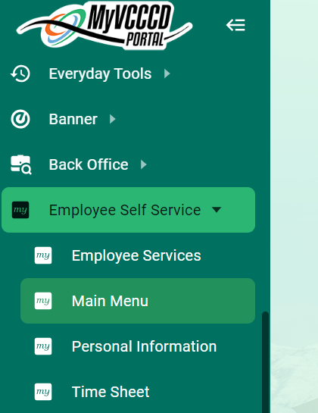
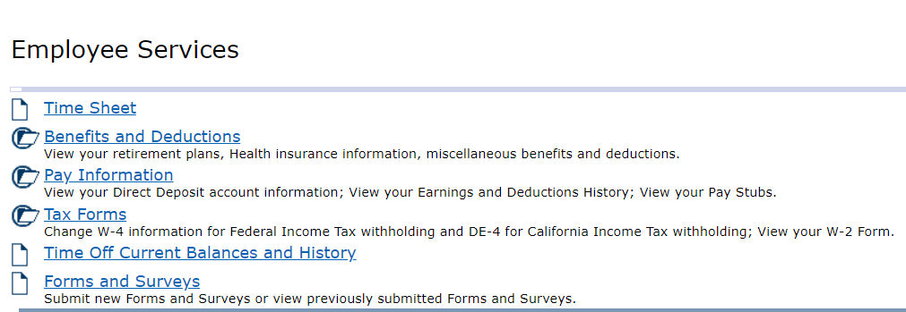
Student Worker Portal
Access your timesheet, paystubs, sick time accrued & change your tax information

Slide 9
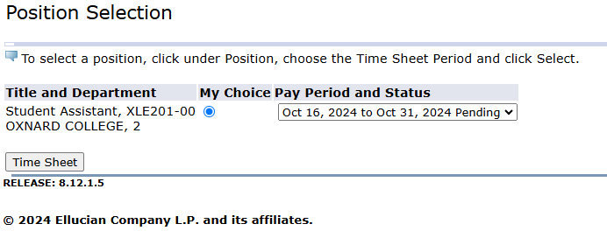
Selecting your timesheet
Verify the pay period dates
If you work for two different departments:
  Ensure you enter your hours on the right assignment

Slide 10
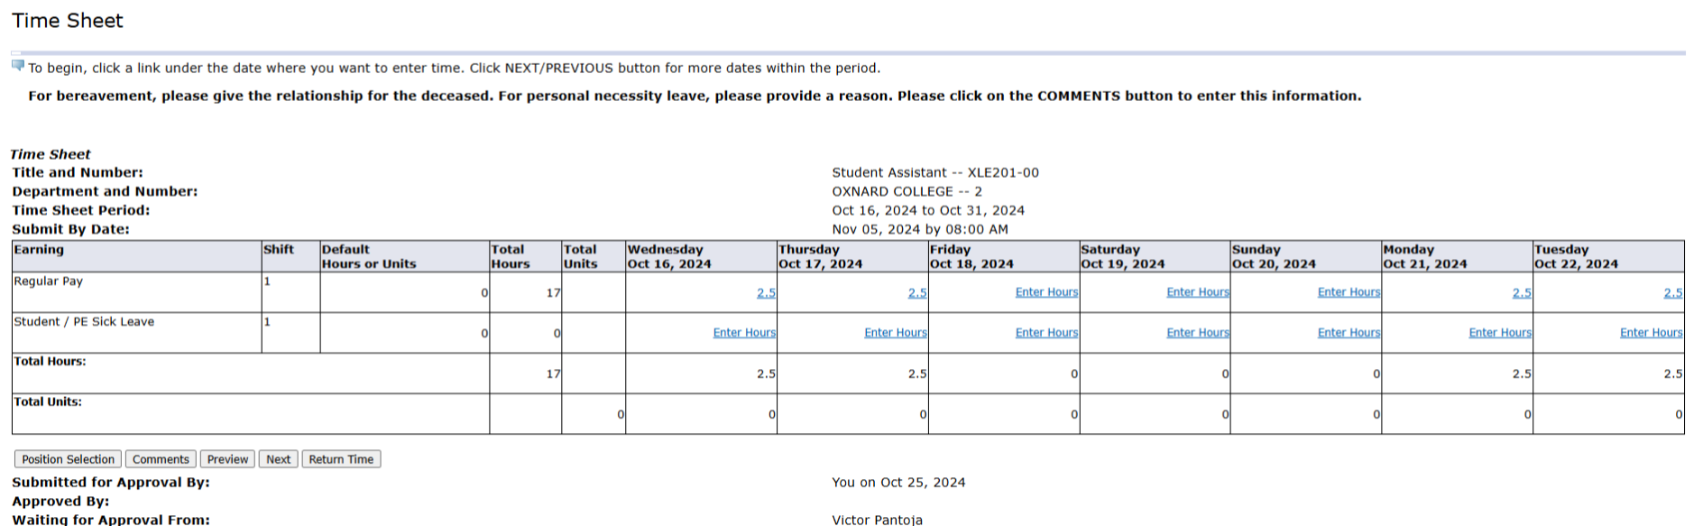
Completing your timesheet
Enter the hours worked
If you are claiming sick hours, please ensure you have hours accrued or the system will automatically deduct at the end of payroll
If you have two assignments, you MUST ensure the hours do not overlap (ex: 5hrs / 4hrs)
Disregard “SUBMIT BY DATE”
DO NOT enter hours for entire pay period before you work the hours (1 exception only)

Slide 11
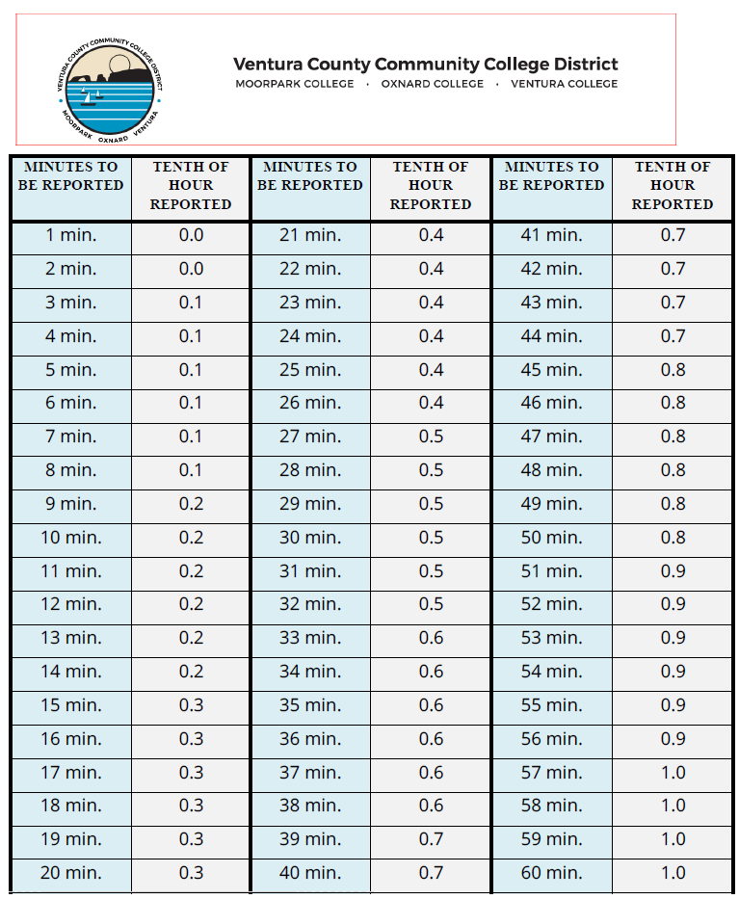
Time Conversions

Slide 12
Pay Periods / Working Days
2 pay periods a month
  1st – 15th
  16th – last day of the month
Make note of holidays and campus closures
  Hours should not be claimed on these days

Slide 13
Deadlines
Deadlines are assigned to us by the district office
  I receive payroll calendars one or two months in advance
Deadlines set according to the day I must submit report to district payroll. Process includes:
  Your submission
  Supervisor review and approval
  I review, audit and process each submission
The only time you can submit hours prior to working them is when the due date is prior to the end of the pay period
Example: Due date for 1st – 15th of the month is due on the 12th

Slide 14
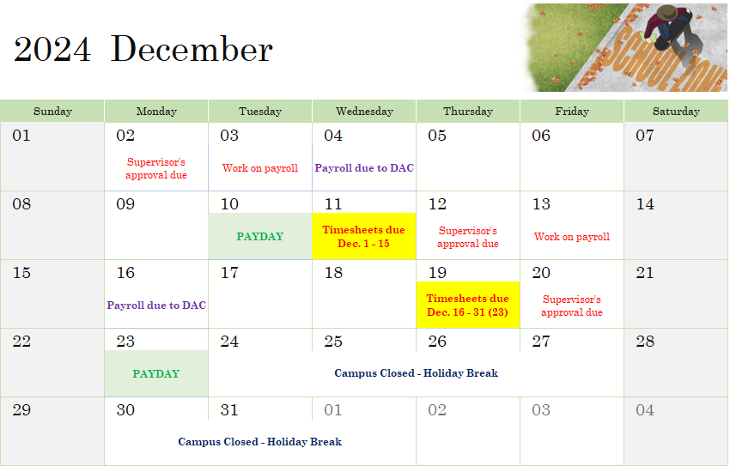

Slide 15
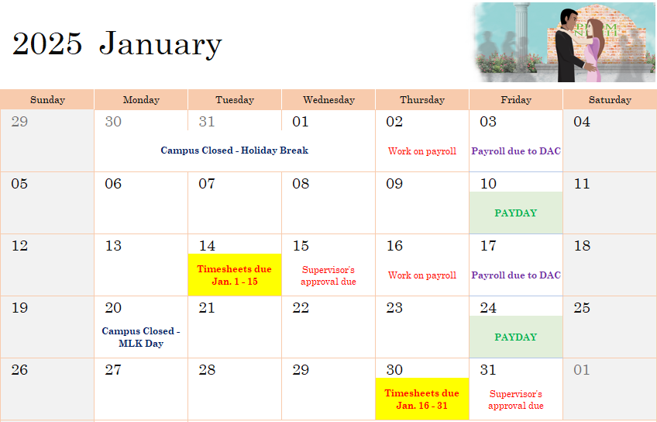

Slide 16
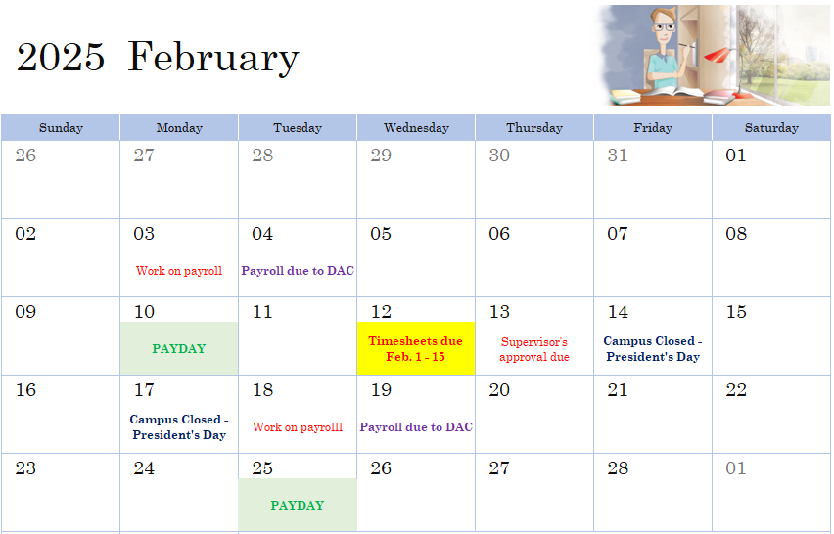

Slide 17
Pay Days
Payday falls on every 10th and 25th
  10th – Pay for the 16th – end of month of previous month
  25th – Pay for the 1st – 15th of current month
If the 10th or 25th fall on a weekend or holiday, you will be paid the last working day
If you receive direct deposit, you will receive it on payday
If you receive a paper check, it will be mailed out that day. It can take a couple of days for you to receive it in the mail

Slide 18
Late timesheets
Timesheets not submitted or approved on time will have to be submitted next pay period
  There is a grace period – you can submit your timesheet no later than the day after it is due
If timesheets are either not submitted or approved by the supervisor’s deadline, a paper timesheet will have to be submitted as soon as possible
  I will try to process the timesheet as soon as possible but cannot guarantee it will be processed during current pay period

Slide 19
P.S.
You can see if your timesheet has been approved by your supervisor
  If there is a mistake and they return the timesheet for correction, you MUST correct and resubmit
I will send an email to you a week before timesheets are due and include upcoming deadlines
  If you would like me to update the email you receive my messages on, please let me know
If you want to start direct deposit or change banking information, you can stop by in person to do so OR email me from your VCCCD email
If you have issues accessing your timesheet, reach out to me

Slide 20

Contact: Berenice Rodriguez
brodriguez@vcccd.edu
805-678-5157

